Slide 1
Expanding Access To Department of Labor (DOL) Data
Building APIs
Tyrone Grandison, PhD
Presidential Innovation Fellow
Department of Labor (DOL)

Slide 2
What is the DOL?
A system of systems:
Many moving parts. Some connected. Some not.
Administrative Review Board (ARB) Benefits Review Board (BRB) Bureau of International Labor Affairs (ILAB) Bureau of Labor Statistics (BLS) Center for Faith-Based &Neighborhood Partnerships (CFBNP) Employee Benefits Security Administration (EBSA) Employees' Compensation Appeals Board (ECAB) Employment & Training Administration (ETA) Job Corps Mine Safety &Health Administration (MSHA) Occupational Safety & Health Administration (OSHA) Office of Administrative Law Judges (OALJ) Office of Congressional & Intergovernmental Affairs (OCIA) Office of the Assistant Secretary for Administration & Management (OASAM) Civil Rights Center | Office of the Assistant Secretary for Policy (OASP) Office of the Chief Financial Officer(OCFO) Office of Disability Employment Policy (ODEP) Office of Federal Contract Compliance Programs (OFCCP) Office of Inspector General (OIG) Office of Labor-Management Standards (OLMS) Office of Public Engagement (OPE) Office of the Solicitor(SOL) Office of Workers' Compensation Programs (OWCP) Ombudsman for the Energy Employees Occupational Illness Compensation Program (EEOMBD) Pension Benefit Guaranty Corporation (PBGC) Veterans' Employment & Training Service (VETS) Wage and Hour Division (WHD) Women's Bureau (WB) Office Of Public Affairs (OPA)

Slide 3
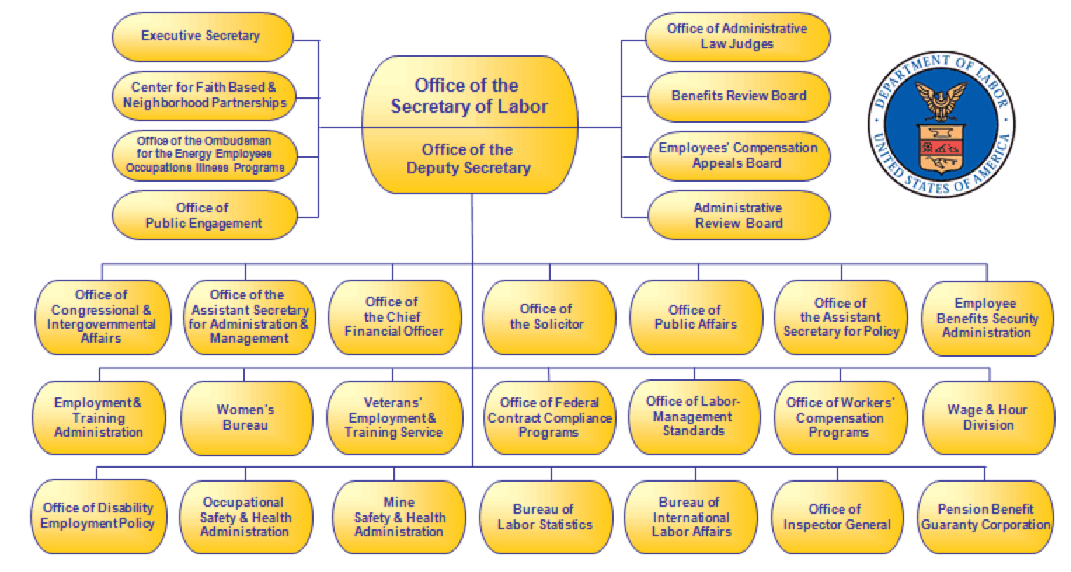
Organizational Structure

Slide 4
Current Landscape
Some agencies provide raw data through text files, Excel sheets and or API
Examples: MSHA, BLS, OSHA, ETA, VETS, WHD, OPA
Current API*
Covers over 200 datasets.
Created by OPA Division of Enterprise Communications.
Sole mission is to provide developers with access to DOL data.
api.dol.gov currently runs on Windows 2008.
*The current API is often referred to as APIv1 or “the legacy API

Slide 5
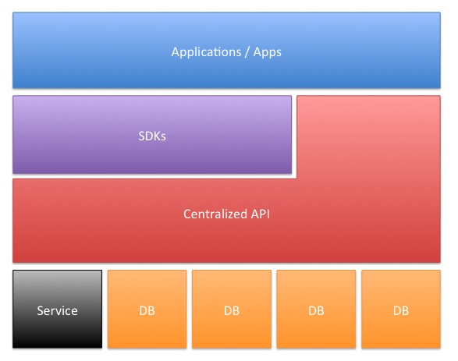
APIv1 Backend
Built using OData.
Solution also contains:
Drupal
Software development kits - not required, but eases the development of applications
Databases
Notes:
An open protocol to allow the creation and consumption of queryable and interoperable RESTful APIs.

Slide 6
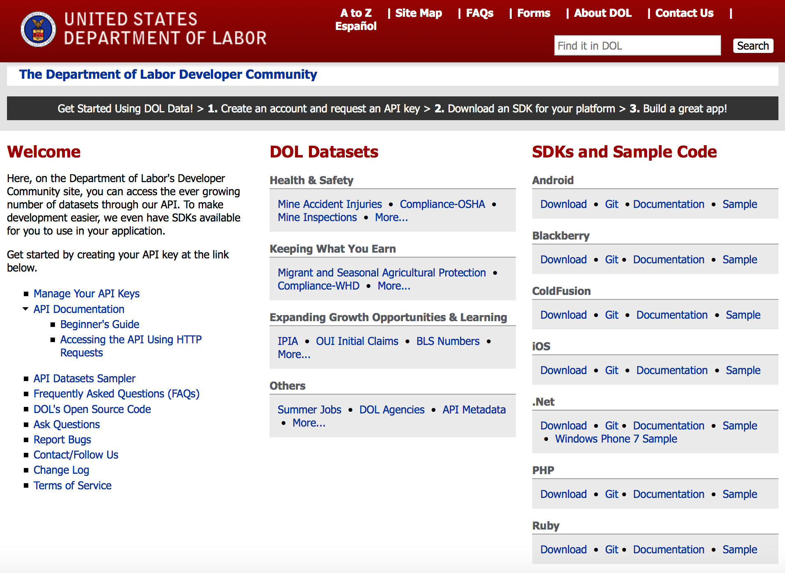
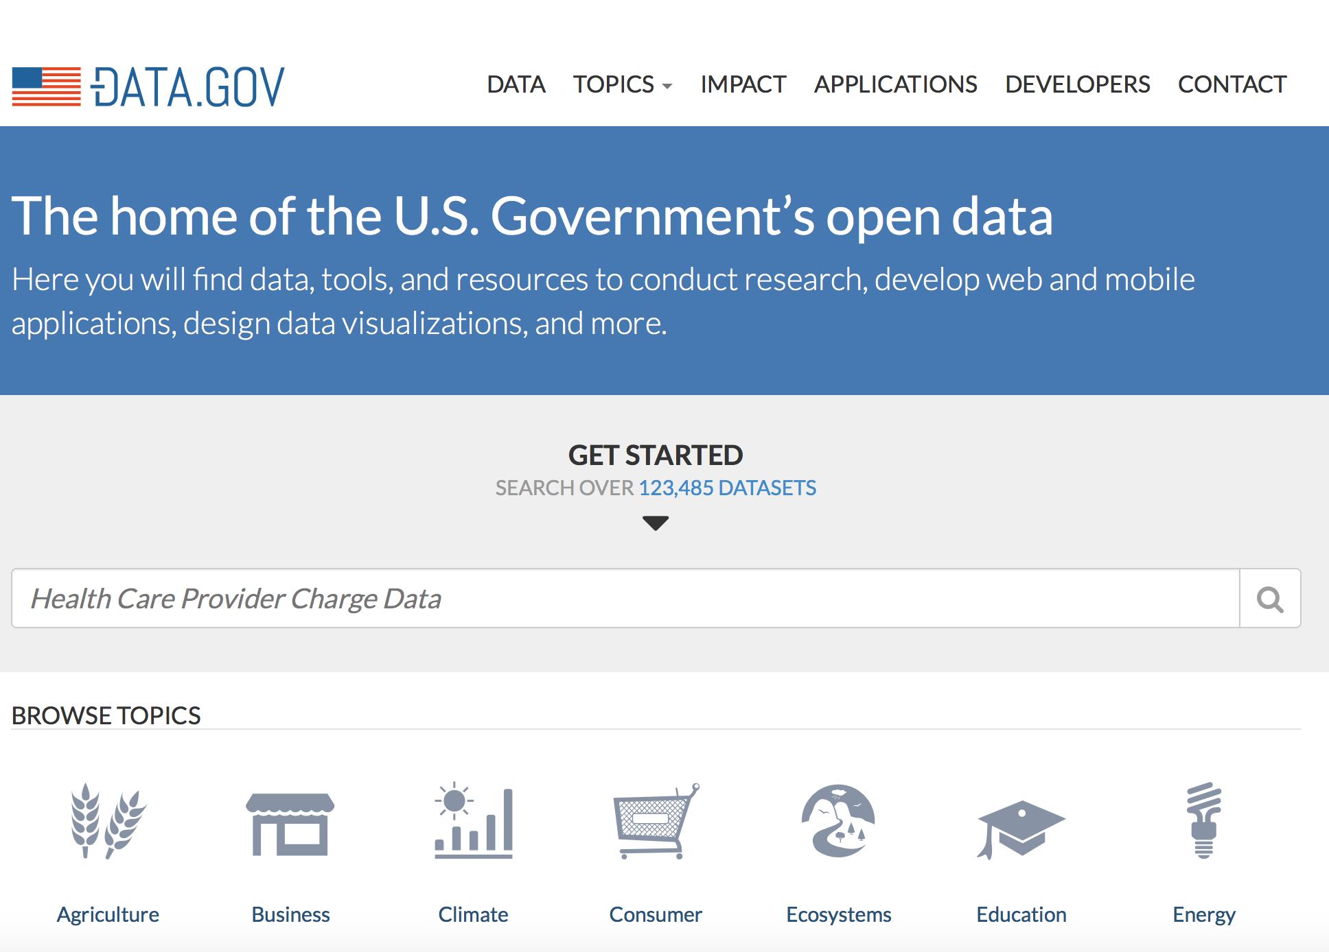
Sources
Department of Labor (DOL) data primarily available at:
DOL’s developer site
Data.gov
Notes:
Executive Order -- Making Open and Machine Readable the New Default for Government Information (May 9th, 2013)
http://www.whitehouse.gov/the-press-office/2013/05/09/executive-order-making-open-and-machine-readable-new-default-government-

Slide 7
Other Sources
Career One Stop
AJC locations; licensing, certification, education, apprenticeship, community college and training info; job listings and job count info.
Occupational Information Network (O*NET)
Detailed profiles of occupations; translations from military occupations, profiles of interests
Notes:
Honorable Mention: https://business.usa.gov/developer

Slide 8
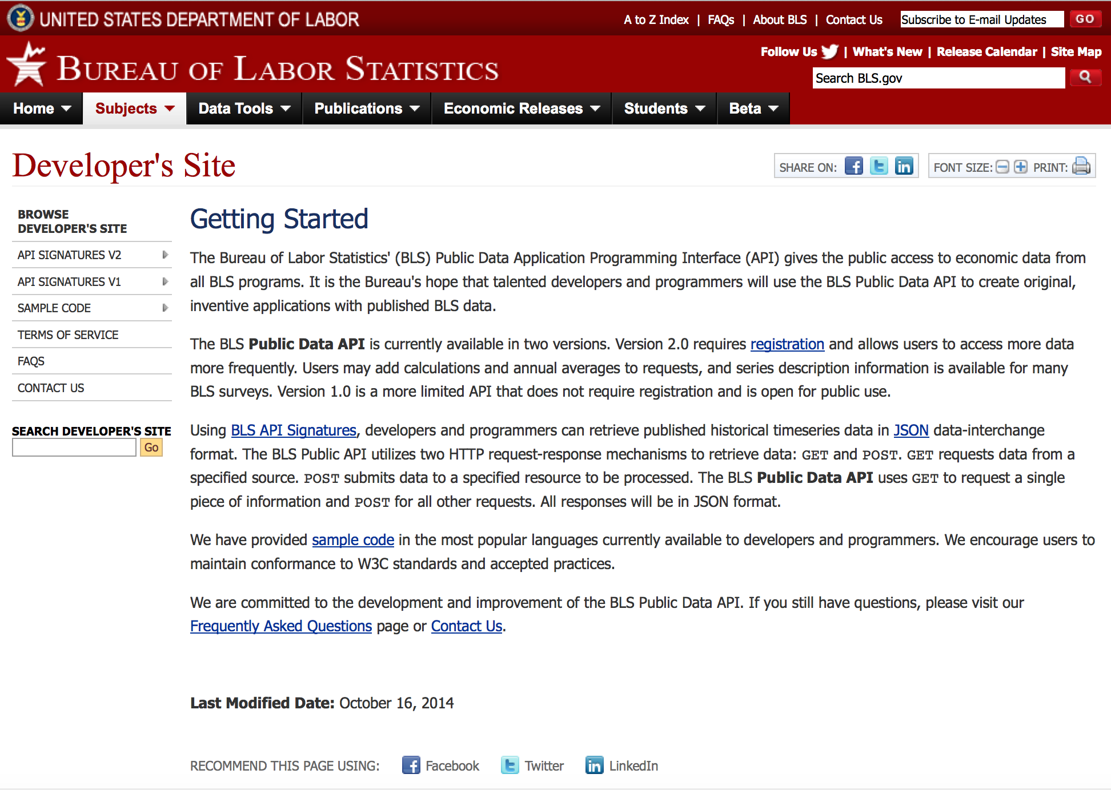
One Last Source
Bureau of Labor Statistics
Labor Market Information

Slide 9
Using APIv1
Register
Visit https://devtools.dol.gov/developer
Click the Register link.
Fill in the registration form and submit it.
A confirmation email will be sent to the address you provided during registration.
Click on the link in the email to activate your developer account.
Create API Key (Token)
Visit https://devtools.dol.gov/developer
At the login page, enter your username and password
Click on the My Tokens link
Click "Create New Token"
Provide a Shared Secret (deprecated, but for the moment still required for the registration process), Application Name, and a Description
The token value will be auto-generated and added to your tokens list.
Access the API
The API is exposed as an OData producer, with the addition of request authorizations.
To make API calls you must supply a valid Token as the "KEY" parameter on the query string with every request.
Example
For DOLAgency and token d9c6c290-da4c-424e-a378-fb4bd027b58b, the direct link to Agency data is: http://api.dol.gov/V1/DOLAgency/Agencies/?KEY=d9c6c290-da4c-424e-a378-fb4bd027b58b
Result Format
By default, the DOL API's responses are in XML format. To receive the data in JSON, send an "Accept" header with "application/json.”

Slide 10
FYI
A lot of the assets are utilizing APIv1.
Some are using their own API standard.
By Q4 2015, all (participating) agencies will move to APIv2.

Slide 11
APIv2 Desired Features
Single sign-on and authentication for datasets with private or sensitive data.
Improved readability and usability of dataset documentation for all skill levels of developers.
Create Internal API with legacy functions, plus CRUD and account deactivation.
Modifying External API and SDKs to facilitate end-user development.
Enable all open data that is available via the API to be available in one of the accepted bulk downloadable formats with options for filtering.
Update Token self-service app to integrate with APIv2, mobile support and new datasets.
Expose DOL web content as structured data via the API.
APIv2 is backwards-compatible with APIv1

Slide 12
APIv2 High Level Requirements
Support requests over SSL/TLS
Support read/write transactions (it is currently read-only)
Continue to require and support API Keys
Continue to be a centralized API
Should not break existing apps using the DOL API
Support the myUSA (if available or equivalent) authentication service
Continue to be a RESTful service that supports all platforms
Same codebase for internal and external deployments
Conform to the 18F API standards to the highest degree practicable
Notes:
18F is a technology team inside the US federal government.

Slide 13
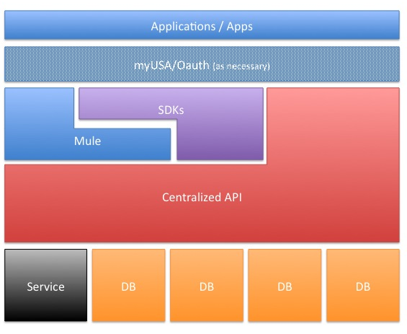
APIv2 Backend
Based on the GitHub - Project Open Data community contributed code
Will run on the LAMP stack.
Will also consist of:
Code Igniter (Ellis Lab) Application Framework
Server Clustering using a Beowulf Cluster to leverage load balancing and parallel processing
Caching using Varnish Cache
Will incorporate Object Oriented Design
Results default to JSON

Slide 14

Live Long and Prosper
Questions: innovationopenhrs@dol.gov

